Slide 1
Intro to CTFs

Slide 2
What are CTFs?
Offensive security competitions that distill fundamental security concepts into smaller challenges
Often referred to as “Jeopardy-style”
Involves solving challenges by searching or determining a “flag” – a specially formatted string that identifies completion of the challenge
https://ctftime.org/ lists upcoming CTFs, past CTFs and associated team scores, the rankings of teams, and links to challenge write-ups (solutions)

Slide 3
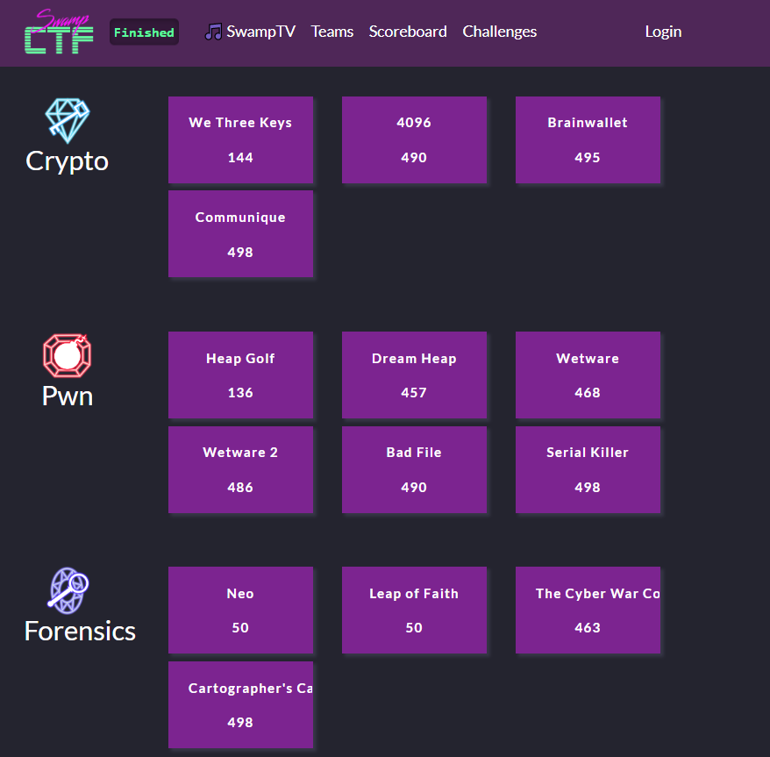
“Jeopardy-Style” Layout

Slide 4
CTF Challenge Categories
Reverse Engineering (RE)
PWN/Binary Exploitation
Forensics
File format forensics
Memory/System dump analysis
Network packet capture analysis
Steganography
Cryptography
Web
PPI
The modules in this course will provide some basic background information on each of these categories

Slide 5
CTF Write-Ups
When a competitor successfully solves a challenge, they may compose a “write-up” of their approach and solution, step-by-step, for others to follow and learn from
Past write-ups can be found on https://github.com/ctfs/

